Slide 1
Data Model
A data model tells us about the underlying structure of a database.
A collection of tools for describing
data
data relationships
data semantics
data constraints

Slide 2
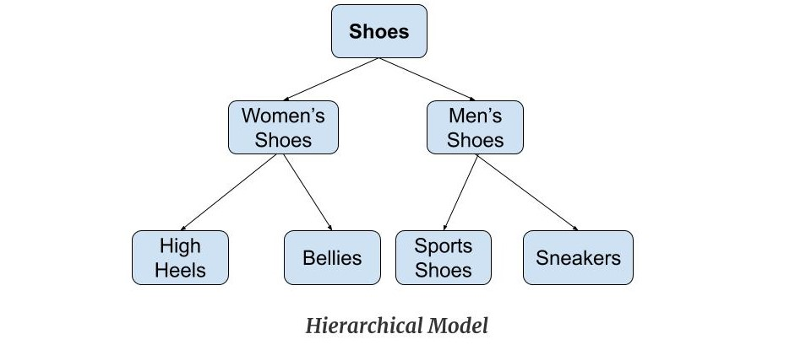
Hierarchical Data Model
This model organizes the data in the hierarchical tree structure.
The hierarchy starts from the root which has root data and then it expands in the form of a tree adding child node to the parent node.
This model easily represents some of the real-world relationships like food recipes, sitemap of a website etc.
Example: We can represent the relationship between the shoes present on a shopping website in the following way:

Slide 3
Features of a Hierarchical Model
One-to-many relationship: The data here is organized in a tree-like structure where the one-to-many relationship is between the data types. Also, there can be only one path from parent to any node.
Parent-Child Relationship: Each child node has a parent node but a parent node can have more than one child node. Multiple parents are not allowed.
Deletion Problem: If a parent node is deleted then the child node is automatically deleted.
Pointers: Pointers are used to link the parent node with the child node and are used to navigate between the stored data.

Slide 4
Advantages of Hierarchical Model
It is very simple and fast to traverse through a tree-like structure.
Any change in the parent node is automatically reflected in the child node so, the integrity of data is maintained.
Disadvantages of Hierarchical Model
Complex relationships are not supported.
As it does not support more than one parent of the child node so if we have some complex relationship where a child node needs to have two parent node then that can't be represented using this model.
If a parent node is deleted then the child node is automatically deleted.

Slide 5
Network Model
This model is an extension of the hierarchical model.
It was the most popular model before the relational model.
This model is the same as the hierarchical model, the only difference is that a record can have more than one parent. It replaces the hierarchical tree with a graph.

Slide 6
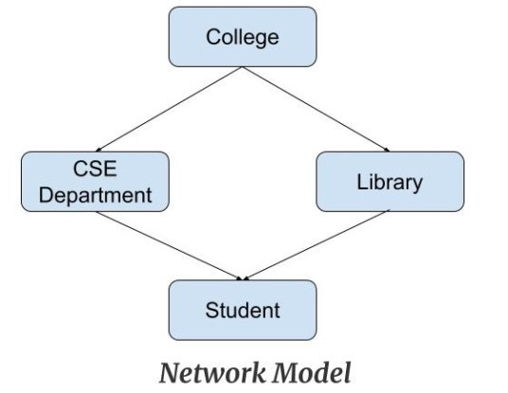
Example for Network Model
In the example below we can see that node student has two parents i.e. CSE Department and Library. This was earlier not possible in the hierarchical model.

Slide 7
Features of Network Model
Ability to Merge more Relationships: In this model, as there are more relationships so data is more related. This model has the ability to manage one-to-one relationships as well as many-to-many relationships.
Many paths: As there are more relationships so there can be more than one path to the same record. This makes data access fast and simple.
Circular Linked List: The operations on the network model are done with the help of the circular linked list. The current position is maintained with the help of a program and this position navigates through the records according to the relationship.

Slide 8
Advantages of Network Model
The data can be accessed faster as compared to the hierarchical model. This is because the data is more related in the network model and there can be more than one path to reach a particular node. So the data can be accessed in many ways.
As there is a parent-child relationship so data integrity is present. Any change in parent record is reflected in the child record.

Slide 9
Disadvantages of Network Model
As more and more relationships need to be handled the system might get complex. So, a user must be having detailed knowledge of the model to work with the model.
Any change like updation, deletion, insertion is very complex.

Slide 10
Entity-Relationship Model
Entity-Relationship Model or simply ER Model is a high-level data model diagram.
In this model, we represent the real-world problem in the pictorial form to make it easy for the stakeholders to understand.
It is also very easy for the developers to understand the system by just looking at the ER diagram.
We use the ER diagram as a visual tool to represent an ER Model. ER diagram has the following three components:
Entities: Entity is a real-world thing. It can be a person, place, or even a concept. Example: Teachers, Students, Course, Building, Department, etc are some of the entities of a School Management System.
Attributes: An entity contains a real-world property called attribute. This is the characteristics of that attribute. Example: The entity teacher has the property like teacher id, salary, age, etc.
Relationship: Relationship tells how two attributes are related. Example: Teacher works for a department.

Slide 11
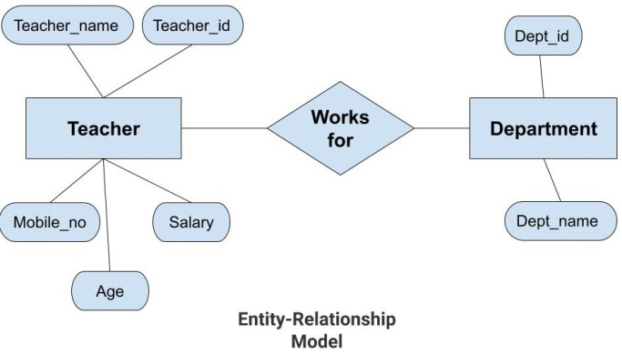
Example for E-R Data Model

Slide 12
Features of ER Model
Graphical Representation for Better Understanding: It is very easy and simple to understand so it can be used by the developers to communicate with the stakeholders.
ER Diagram: ER diagram is used as a visual tool for representing the model.
Database Design: This model helps the database designers to build the database and is widely used in database design.

Slide 13
Advantages of ER Model
Simple: Conceptually ER Model is very easy to build. If we know the relationship between the attributes and the entities we can easily build the ER Diagram for the model.
Effective Communication Tool: This model is used widely by the database designers for communicating their ideas.
Easy Conversion to any Model: This model maps well to the relational model and can be easily converted relational model by converting the ER model to the table. This model can also be converted to any other model like network model, hierarchical model etc

Slide 14
Disadvantages of ER Model
No industry standard for notation: There is no industry standard for developing an ER model. So one developer might use notations which are not understood by other developers.
Hidden information: Some information might be lost or hidden in the ER model. As it is a high-level view so there are chances that some details of information might be hidden.

Slide 15
Relational Model
Relational Model is the most widely used model.
In this model, the data is maintained in the form of a two-dimensional table. All the information is stored in the form of row and columns.
The basic structure of a relational model is tables. So, the tables are also called relations in the relational model.
Example: In this example, we have an Employee table.

Slide 16
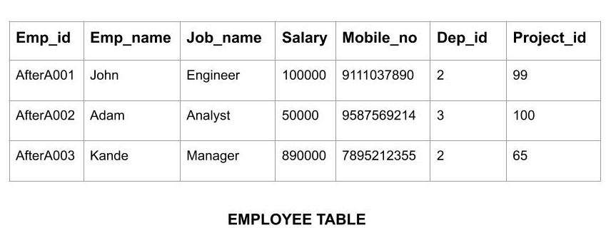

Slide 17
Features of Relational Model
Tuples: Each row in the table is called tuple. A row contains all the information about any instance of the object. In the above example, each row has all the information about any specific individual like the first row has information about John.
Attribute or field: Attributes are the property which defines the table or relation. The values of the attribute should be from the same domain. In the above example, we have different attributes of the employee like Salary, Mobile_no, etc.

Slide 18
Advantages of Relational Model
Simple: This model is more simple as compared to the network and hierarchical model.
Scalable: This model can be easily scaled as we can add as many rows and columns we want.
Structural Independence: We can make changes in database structure without changing the way to access the data. When we can make changes to the database structure without affecting the capability to DBMS to access the data we can say that structural independence has been achieved.

Slide 19
Disadvantages of Relational Model
Hardware Overheads: For hiding the complexities and making things easier for the user this model requires more powerful hardware computers and data storage devices.
Bad Design: As the relational model is very easy to design and use. So the users don't need to know how the data is stored in order to access it. This ease of design can lead to the development of a poor database which would slow down if the database grows.

Slide 20
Object-Oriented Data Model
The real-world problems are more closely represented through the object-oriented data model.
In this model, both the data and relationship are present in a single structure known as an object.
We can store audio, video, images, etc in the database which was not possible in the relational model(although you can store audio and video in relational database, it is advised not to store in the relational database).
In this model, two are more objects are connected through links. We use this link to relate one object to other objects.

Slide 21
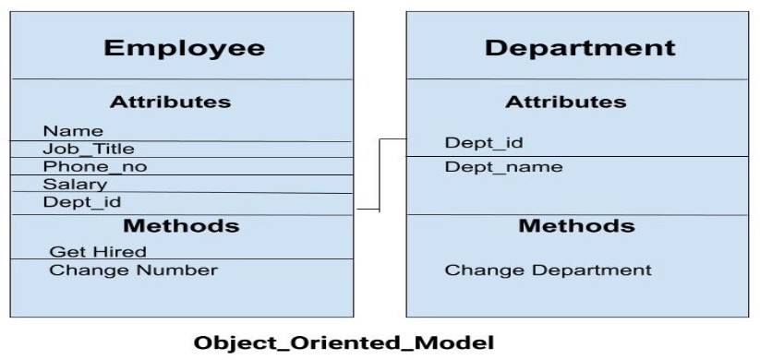
Example for Object- Oriented Data Model

Slide 22
Object-Relational Model
As the name suggests it is a combination of both the relational model and the object-oriented model.
This model was built to fill the gap between object-oriented model and the relational model.
We can have many advanced features like we can make complex data types according to our requirements using the existing data types.

Slide 23
Database Users and Administrators
A primary goal of database system is to retrieve information from and store new information in the database. People who work with a database can be categorized as database users or database administrators.

Slide 24
Database Users
There are four different types of database-system users, differentiated by the way they expect to interact with the system.
Naïve Users are unsophisticated users who interact with the system by invoking one of the application programs that have been written previously. For example a bank teller who transfers Rs. 500 from account A to account B invokes a program called transfer. People, who wish to check their balance over the worldwide web, are the other example for naïve users. Naïve users use the forms as their user interfaces and can read the reports.
Application Programmers are computer professionals who write application programs. Application programmers can choose from many tools to develop user interfaces. RAD (Rapid Application Development) Tools are the tools that enable an application programmer to construct forms and reports with minimal programming effort.

Slide 25
Database Users
Sophisticated Users interact with the system without writing programs. Instead, they form their requests in a database query language. They submit each query to the query processor. The job of a query processor is to bread down the DML statements in to instructions so that they can be understood by the storage manager. Analysts who submit queries to explore or extract data in the database will fall in this category.
Specialized Users are sophisticated users who write specialized database applications that do not fit into the traditional data processing framework. CAD systems, knowledge based expert systems are the examples for such specialized database applications.
End Users:
Persons who add, delete, and modify data in the database and who request and receive information from it.

Slide 26
Database Administrator
The database administrator (DBA) is the person (or group of people) responsible for overall control of the database system. The DBA would normally have a large number of tasks related to maintaining and managing the database. The DBA's responsibilities include the following:
Schema Definition. The DBA creates the original database schema by executing a set of data definition statements in the DDL.
Storage Structure and access-method definitions.
Schema and physical organization modification. The DBA carries out changes to the schema and physical organization to reflect the changing needs of the organization, or to alter the physical organization to improve performance.

Slide 27
Granting of authorization for data access. By granting different types of authorization, the database administrator can regulate which parts of the database the users can access. The authorization information is kept in a special system structure that the database system consults whenever someone attempts to access the data in the system.
Routine maintenance. Examples of the database administrator’s routine maintenance activities are:
Periodically backup the database, either on to tapes or on to remote servers, to prevent loss of data incase of natural calamities like flooding.
Ensuring that enough disk space is available for normal operations, and upgrading disk space as required.
Monitoring jobs running on the database and ensuring that performance is not degraded by very expensive tasks submitted by some users.

